Slide 1
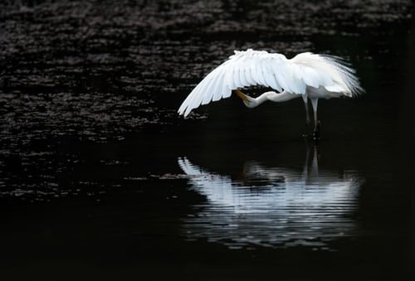
A reflection:
Amalgamated sections
of the ‘Weekly poems
in Covid-19 times’ -
from 16th March to 8th June

Slide 2

When despair for the world grows in me
I come into the Presence.
For a time
I rest in the grace of the world,

Slide 3





give up, just for now,
on trying to make the world
different than it is.

Slide 4

Yes there is fear.
Yes there is isolation.
Yes there is panic buying.
Yes there is sickness.
Yes there is even death.
Yet …
All over the world people are slowing down and reflecting.
All over the world people are looking at their neighbours in a new way.
All over the world people are waking up to a new reality:
To how big we really are.
To how little control we really have.
To what really matters.

Slide 5
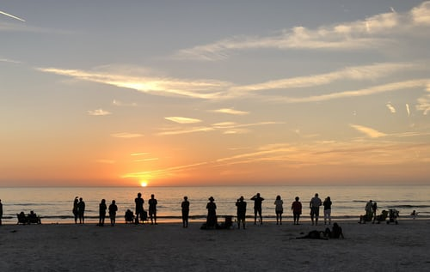
When this is over,
may we never again
take for granted
a handshake with a stranger,
the taste of communion.
Life itself.

Slide 6


Sometimes as an antidote
I eat the stars.
Sometimes, instead, I stir myself
into a universe still young,
still warm as blood:

Slide 7
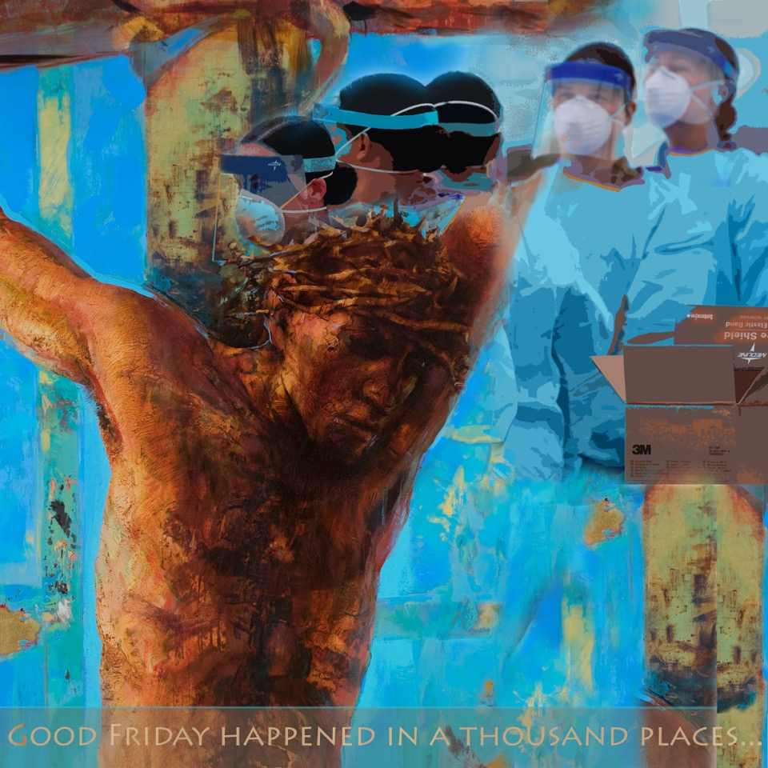
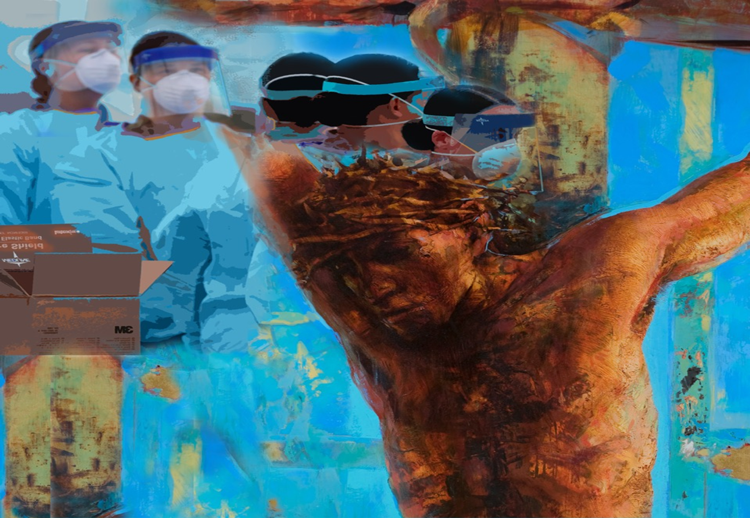
And where is Jesus?
He is up and risen, long before,
Alive, at large, and making his strong way
into the world he gave his life to save.
He slips
Away from church, shakes off our linen bands
to don his apron with a nurse:

Slide 8

“How do you do? I’ll not shake hands
or hug you like I would:
normal seems to be on hold!”
I gaze through prisoned glass,
safe-masked,
unsure …
while Mother Earth is blackened:

Slide 9
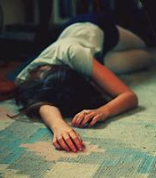
If you fall down, we’re told,
you shouldn’t get up right away.
We have
fallen.
HARD.
It’s ok to lie here a while,
enjoying the peace.

Slide 10
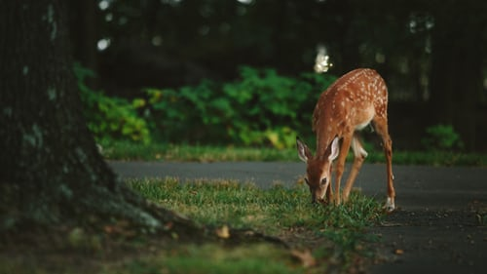
The deer are reclaiming the woods -
each hoof print a hopeful rebellion.
The paths that we once trod
now lie bare in this small revolution.

Slide 11

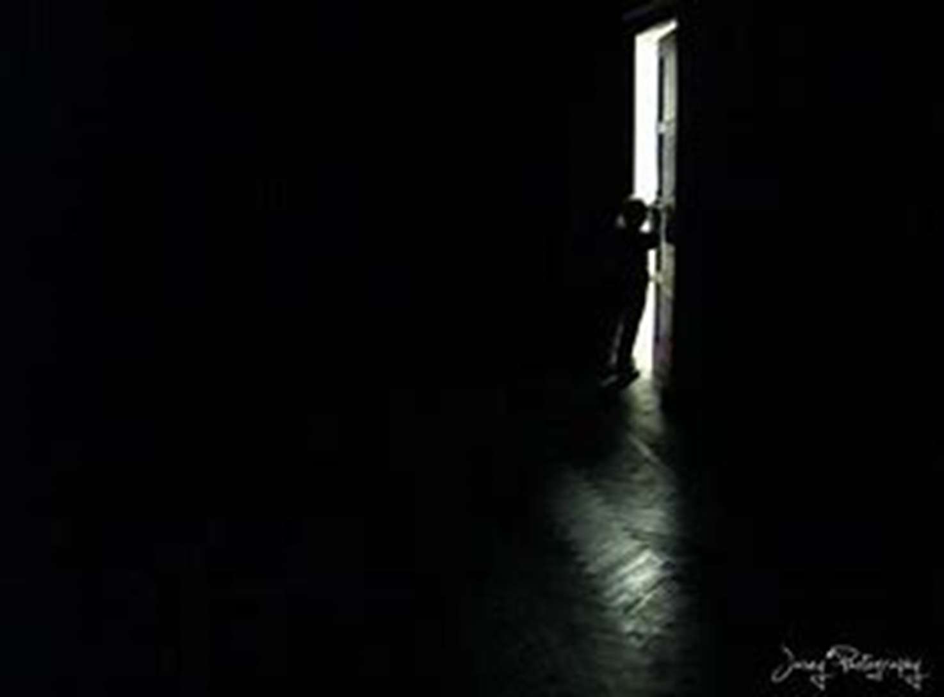
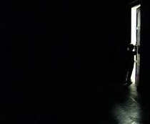
For those outside locked doors,
in the moments of encounter,
in the richness that sustains our spirits,
in the renewal of nature,
peace be with you
For those behind locked doors,
fearful of illness,
poverty, violence
and loneliness,
we seek a blessing.

Slide 12


like you’ve only now remembered
you are alive.

Slide 13
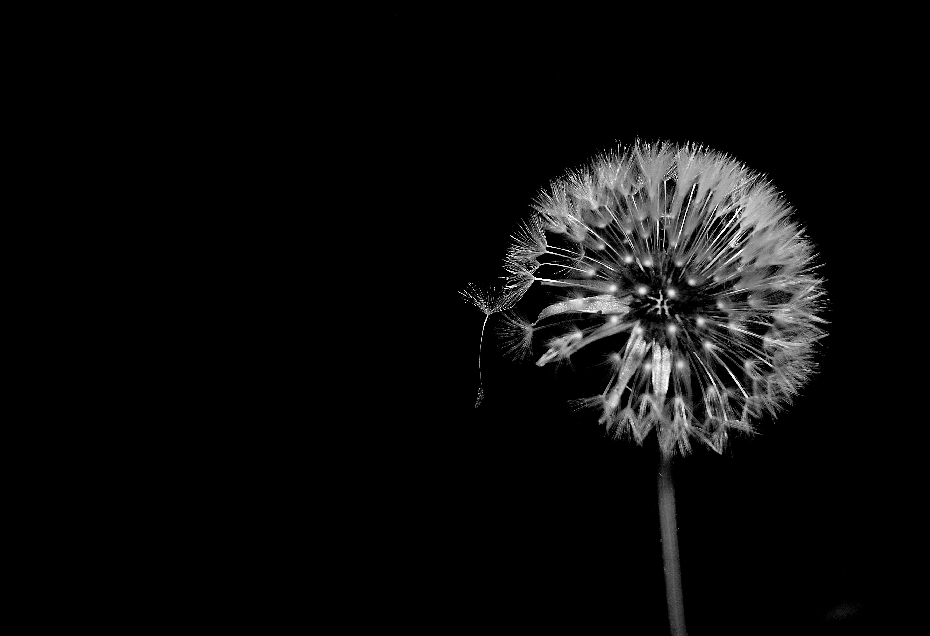
Give us resolution …
courage …
persistence …
strength …
acceptance …
grace …
and wisdom to discriminate between our own impatience to move forward
and your Spirit’s deep stirring of our spirits when the time is right to move.

Slide 14
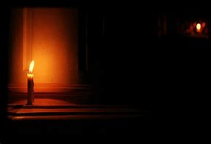
To all that is chaotic
let there come silence:
an opening
into the quiet
that lies beneath
the chaos,
where you find
the peace
you did not think
possible,

Slide 15


moments of revelation near leaves, sunlight and skin.
And wonky, colourful .
rainbows

Slide 16
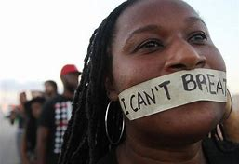
For there is a time for mercy
and there is a time for reflection.
There is a time for certainty
and there is a time for unknowing:
soft protection for seeds
unready to face full sun.

Slide 17


So we pray for our locked-down, longing world.
Yes there is fear.
But there does not have to be hate.
Yes there is isolation.
But there does not have to be loneliness.
Yes there is panic buying.
But there does not have to be meanness.
Yes there is sickness.
But there does not have to be dis-ease of the soul.
Yes there is even death.
But we are always encompassed by Love.
Wake to the choices you make,
open the windows of your soul.
And though you may not be able
to touch across the empty square,
sing.

Slide 18
Credits for all sections of poems used in this reflection:
an amalgamation from the ‘Weekly Poems in Covid-19 times’, 16th March – 8th June
16th March Wendell Berry ‘The peace of wild things’, in The Peace of Wild Things (2018).
23rd March Lyn Ungar ‘Pandemic’, http://www.lynnungar.com/poems/pandemic/
30th March Richard Henrick ‘Lockdown’,
https://brorichardblog.blogspot.com/2020/03/lockdown-brother-richard-hendrick.html
6th April Laura Fanucci ‘When this is over’, https://motheringspirit.com/?s=when+this+is+over
13th April Rebecca Elson ‘Antidotes to fear of death’, in A Responsibility to Awe (2001).
20th April Malcom Guite ‘Easter 2020’, https://malcolmguite.wordpress.com/?s=Easter+2020
27th April Paul Booth ‘Creative Distancing’
Christine Crabtree ‘If you fall down’
Laura Sutcliffe ‘In this moment’
4th May Jan Berry ‘Behind locked doors’
11th May Carrie Etter ‘How to handle a pandemic’,
https://www.mmu.ac.uk/write/how-to-handle-a-pandemic.php
18th May Nicola Slee ‘Prayer for the waiting time’, in Praying Like A Woman (2004).
25th May Jan Richardson ‘Blessings in the Chaos’, in The Cure for Sorrow: A Book of Blessings for
Times of Grief (2016).
1st June Miles Salter ‘That spring’, https://www.mmu.ac.uk/write/that-spring-.php
8th June Carla Grosch-Miller ‘There is a time’, in Lifelines: Wrestling the Word, Gathering up Grace (2020).

